Slide 1
Overview of Structured Decision Making
Module 1
Developed by:
Sarah J Converse,
US Geological Survey Washington Cooperative Fish and Wildlife Research Unit,
School of Environmental and Forest Sciences & School of Aquatic and Fishery Sciences,
University of Washington
Workshop: Fundamentals of Structured Decision Making
The Wildlife Society 2020 Annual Conference
October 2, 2020

Slide 2
What is a decision?
“Decisions are the only means you have to change your future life.” Ronald Howard
A decision is a conscious choice among two or more alternatives that allocate resources (e.g., time, money) in your control:
I decide to take the day off and go hiking
You buy a new car
An important decision is characterized by an irrevocable allocation of resources

Slide 3
What is a good decision?
One that achieves a good result?
Or one that follows a process most likely to achieve a good result?
Can a bad decision lead to a good outcome?
The new refuge manager tells his staff, “I don’t need data. I have a gut feeling about how to manage for this endangered butterfly.” He implements his plan and the butterfly population increases.
Was this a good decision? Why do you think so?

Slide 4
What is a good decision?
We can’t perfectly control the outcome of our decisions, but we can control the way in which we make decisions
Our goal should be a decision process that will improve – even maximize – the probability of a good outcome

Slide 5
When do we need a structured decision-making process?
Each of us makes many decisions through the day, and most of those decisions we make quickly and automatically.
How did you decide…
What to eat for breakfast?
What to wear today?
Whether to share or hide your video?
Do all our decisions deserve careful thought?

Slide 6
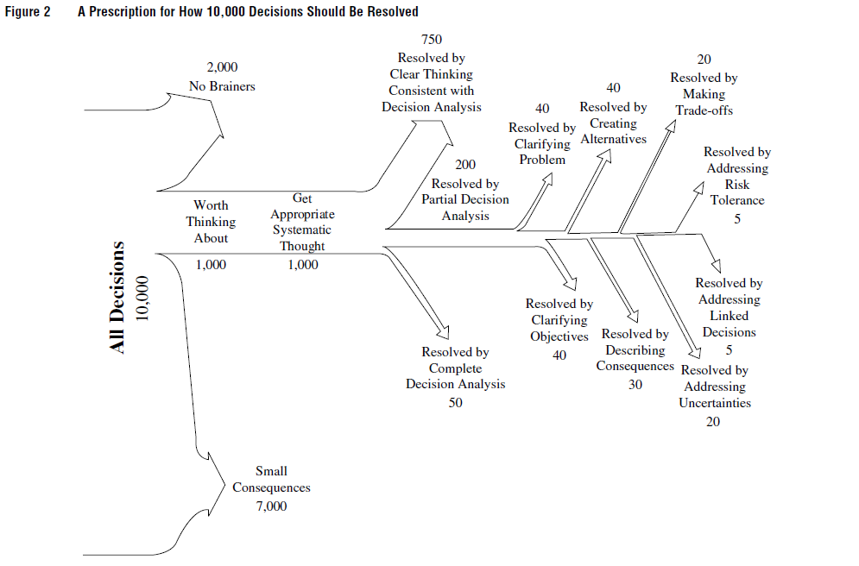
Decisions worth thinking about
Keeney 2004. Making better decision makers.
Decision Analysis 1:193-204.

Slide 7
Decisions worth thinking about
Decisions worth thinking about:
have meaningful consequences
are not “no brainers”
What makes decisions hard?
The objectives are contradictory or complex
The alternatives are unknown
We have significant uncertainty about outcomes
Even knowing everything else, the best alternative is difficult to identify

Slide 8
Why do we need a structured decision-making process?
To help us:
deal with the factors that make decisions hard
overcome our cognitive biases
Just like the scientific method helps us to overcome our cognitive biases in understanding how the world works, decision analysis helps us to overcome our cognitive biases in decision making
be sure we’ve accounted for all the important factors and integrated all the relevant information
explain to others how we reached a decision

Slide 9
What are our natural tendencies as decision makers?
To make decisions, we have to:
Make judgments or forecasts
Deal with complexity
People use heuristics (cognitive shortcuts) for completing these tasks quickly
Some of these heuristics represent “cognitive biases” that can steer us wrong

Slide 10
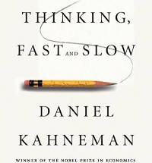
What are our natural tendencies as decision makers?
Two cognitive systems
System 1 makes snap judgements
System 2 does the hard thinking but is lazy and will defer to System 1
System 1 has some advantages…
So does System 2…

Slide 11
What are our natural tendencies as decision makers?
A few examples of heuristics
Anchoring
Representativeness heuristic
Recognition heuristic

Slide 12
What are our natural tendencies as decision makers?
Anchoring: we make an initial judgment and then deviate only slightly based on additional information

Slide 13
What are our natural tendencies as decision makers?
Anchoring: we make an initial judgment and then deviate only slightly based on additional information
Group 1: 8*7*6*5*4*3*2*1 = ?
Group 2: 1*2*3*4*5*6*7*8 = ?

Slide 14
What are our natural tendencies as decision makers?
Anchoring: we make an initial judgment and then deviate only slightly based on additional information
Group 1: 8*7*6*5*4*3*2*1 = ?
Average estimate: 2250
Group 2: 1*2*3*4*5*6*7*8 = ?
Average estimate: 512
Answer: 40,320

Slide 15
What are our natural tendencies as decision makers?
Representativeness Heuristic: we judge the likelihood of an event based on the degree to which it seems to have the key features of the generating process
Which random poker hand is more likely?
Hand 1: 10♠, J♠, Q♠, K♠, A♠
Hand 2: 4♦, 4♥, 6♠, 7♣, Q♥

Slide 16
What are our natural tendencies as decision makers?
Recognition Heuristic: we judge the value of things based on our familiarity with them
Can you think of some evidence that the recognition heuristic is a powerful force in our decision making?

Slide 17
What are our natural tendencies as decision makers?
Heuristics are not always bad
A car has run a traffic light and I am headed straight for it. What do I do?
But they can:
cause you to limit the search for relevant information
make you rely on ingrained short cuts
lead you to be overconfident by discounting complexity or disconfirming information
bias your perceptions and lead to sub-optimal decisions

Slide 18
What is SDM?
Pr
O
T
A
C
PrOACT
Defining the Problem
Determining the Objectives
Identifying Alternatives
Forecasting the Consequences
Evaluating the Trade-offs
Taking additional steps: e.g., sensitivity analysis
Making the decision and taking action
Monitoring the outcome

Slide 19
PrOACT Framework
Problem Framing
Implement Action
Elicit Objectives
Identify Preferred Alternative
Develop Alternatives
Evaluate Consequences
from Runge MC, Grand JB, Mitchell MS. 2013. Structured decision making. Chapter 5 in Krausman PR, Cain JW III, eds. Wildlife Management: Contemporary Principles and Practices. Johns Hopkins University Press, Baltimore, Maryland.

Slide 20
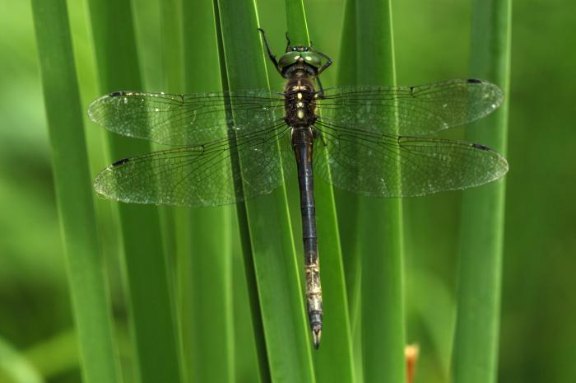
Hines Emerald Dragonfly

Slide 21
The Problem…
Pr
O
T
A
C
Which chemical should we use to manage invasive plants that threaten HED habitat?
Can we succeed without chemicals? (e.g. mow, burn, or both)
Should we treat in spring, summer, or fall?
Or, maybe we shouldn’t do anything all?
So many options…what to do?
Decision Problem Definition: What is the best habitat management approach we can take to conserve the HED, while meeting other objectives and controlling costs?

Slide 22
The Objectives…
Pr
O
T
A
C
Fundamental
Ensure persistence of the HED population
Ensure persistence of native grassland vegetation
Control costs
Means
Maintain suitable HED habitat
Promote native species by reducing invasives
Manage multiple sites

Slide 23
The Alternatives…
Pr
O
T
A
C
Management Actions:
Chemical
Non-chemical treatments (mowing, burning, grazing)
Chemical & mowing or burning
No treatment
Permutations
Chemical options
Application method
Application time period
Management Alternatives
many alternatives: (3 non-chemical options x 5 chemical options x 3 application methods + 5 chemical options x 2 application methods x 4 application periods x 4 add-on options = 205 alternatives)

Slide 24
The Consequences…
Pr
O
T
A
C
Predict → Models
How HED would respond if exposed to treatments
How native vegetation would respond
How successful the treatment would be in controlling the invasive species
How much would the management action cost over multiple sites and years
These models might be mental, conceptual, or quantitative
But they need to explicitly link actions to objectives

Slide 25
The Tradeoffs…
Pr
O
T
A
C
Optimal solution found by integrating:
Objectives
Actions
Models
Identify the action and its timing that best achieve the objectives
An optimal solution might be to:
Clearcast via backpack spray in combo with early spring mowing

Slide 26
What is SDM?
Pr
O
T
A
C
Decision analysis is “a formalization of common sense for decision problems which are too complex for informal use of common sense.”
- Ralph Keeney

Slide 27
What is SDM?
Pr
O
T
A
C
SDM in 31 words:
What do you want?
What can you do?
How do things you can do change what you want?
Choose from things you can do to get what you want
Do
Learn
- Hugh Possingham

Slide 28
What is SDM?
Pr
O
T
A
C
“I used to think of decision analysis as common sense for solving difficult decision problems.”
“Now I think that the more important role of decision analysis is a way of thinking through any of the decisions you face.”
- Ralph Keeney

Slide 29
Decisions worth thinking about
Pr
O
T
A
C
Keeney 2004. Making better decision makers.
Decision Analysis 1:193-204.

Slide 30
How much analysis is needed?
Pr
O
T
A
C
How far along Keeney’s tree diagram do I need to go?
Structure and analyze the problem only as much as is needed to reach a good decision
Hard to recognize at the beginning how much analysis is needed (more art than science)

Slide 31
Getting Underway: Rapid Prototyping
Pr
O
T
A
C
Rapid Prototyping
Start simple, try it out, change or add where needed
A prototype is amenable to testing and ‘trial and error’
Low effort, so less resistant to change if warranted
Application to structuring decisions
Sketch the decision structure
Add complexity as needed
Gain insight and revise
Revise as needed until a decision is reached

Slide 32
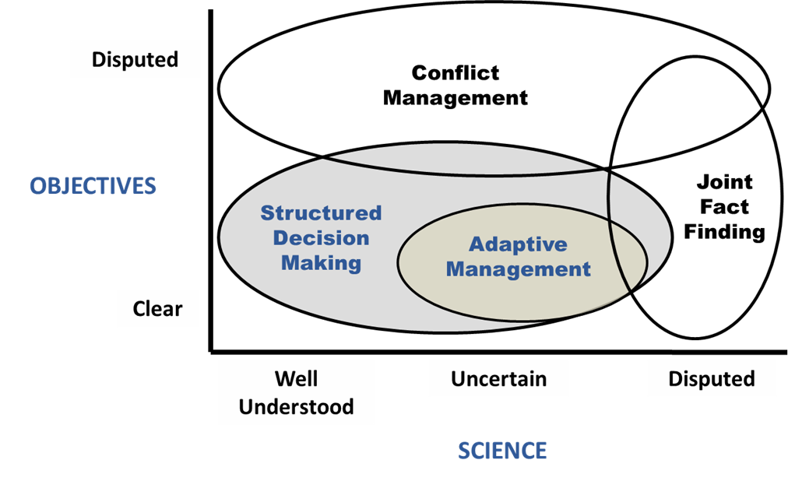
When does SDM apply?
Pr
O
T
A
C
SDM works best in the absence of disputes about values or knowledge.
But a structured decision process can work to reduce dispute and move towards collaboration.

Slide 33
Building a Cognitive Framework
Pr
O
T
A
C
Unfortunately, all the scientific information in the world cannot tell a manager what course is best, if that information is not placed within a cognitively tractable framework.
This is the essential basis of Sherlock Holmes' three-pipe problem – when faced with a complex and pressing need to undertake a course of action, it is prudent to stop and think hard about the decision of how to act.
- Converse and Grant 2019. A three-pipe problem: dealing with complexity to halt amphibian declines. Biological Conservation 236:107-114.
“But I must be prompt over this matter.” [said Holmes.]
“What are you going to do, then?” I asked.
“To smoke,” he answered. “It is quite a three pipe problem, and I beg that you won't speak to me for fifty minutes.”
- The Red Headed League, Sir Arthur Conan Doyle

Slide 34
EXERCISE
Pr
O
T
A
C
Think about your research. Consider a decision your research results might help to address.
What is the decision?
Who will have to make it?
When will they have to make it?
Under what (legal) authority will they make it?
What will be the spatial/temporal scope covered?
What are some likely objectives?
Distinguish fundamental (important for their own sake) from means (important because they might help you reach a fundamental objective) – use the WITI question to help you think about this
Don’t miss out on things like budget, conforming to legal mandates, public opinion, etc.
What are some likely alternatives? What form do these take?

